Slide 1
COMP-SCI 5540 Principles of Big Data Management
Team 6 -
Vinay Jaibheem
Pranoop Mutha
Trinadha Raji Muppala

Slide 2
Objective
Analyzing Twitter Data using Spark SQL in Scala
Collect social media data (tweets) using any theme as filter
Delivers knowledge on the filtered data for analysis.

Slide 3
Design Steps
Collect data from social media(tweets) using Python and store it in a JSON file
Now we load the JSON file into HDFS.
A Spark Session is created to establish connection to Spark Cluster to read data directly from HDFS
Now we divide the JSON data into twitter data and user data.
Data Frames are created based on content of JSON file and register it to tables
Run SQL queries programmatically using SQL function on registered tables
We have used Tableau and Word Cloud for visualization

Slide 4
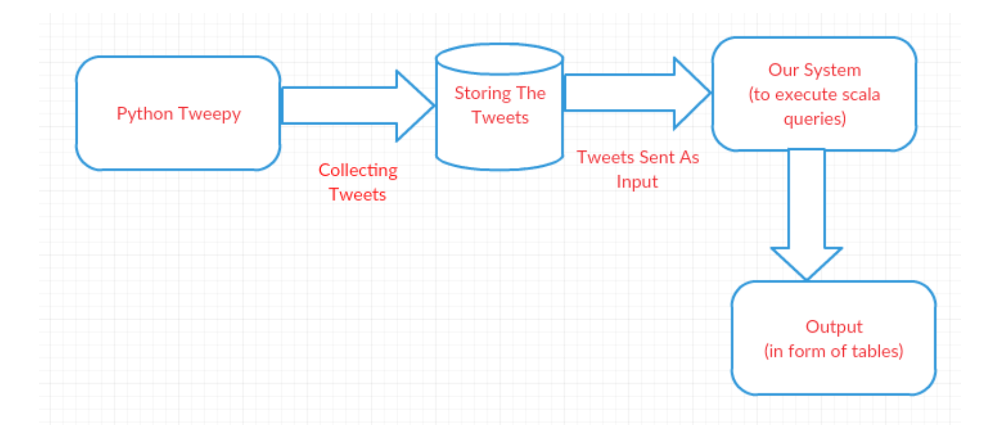
ARCHITECTURE

Slide 5










Technology

Slide 6
Libraries
Spark Core contains the basic functionality of Spark and Spark SQL is Spark’s package for working with Structured data
Signpost has been designed to work in conjunction with Apache HTTPComponents library for signing HTTP messages on the Scala platform in conformance with the OAuth Core 1.0 standard
Tweepy – An easy-to-use Python library for accessing the Twitter API

Slide 7
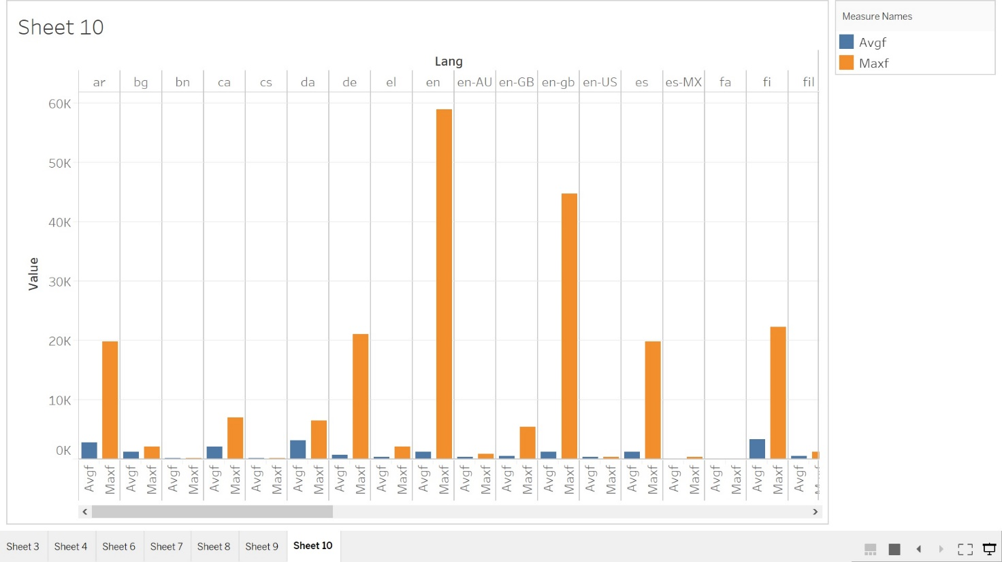
Output
According to average and maximum friends count based on language

Slide 8
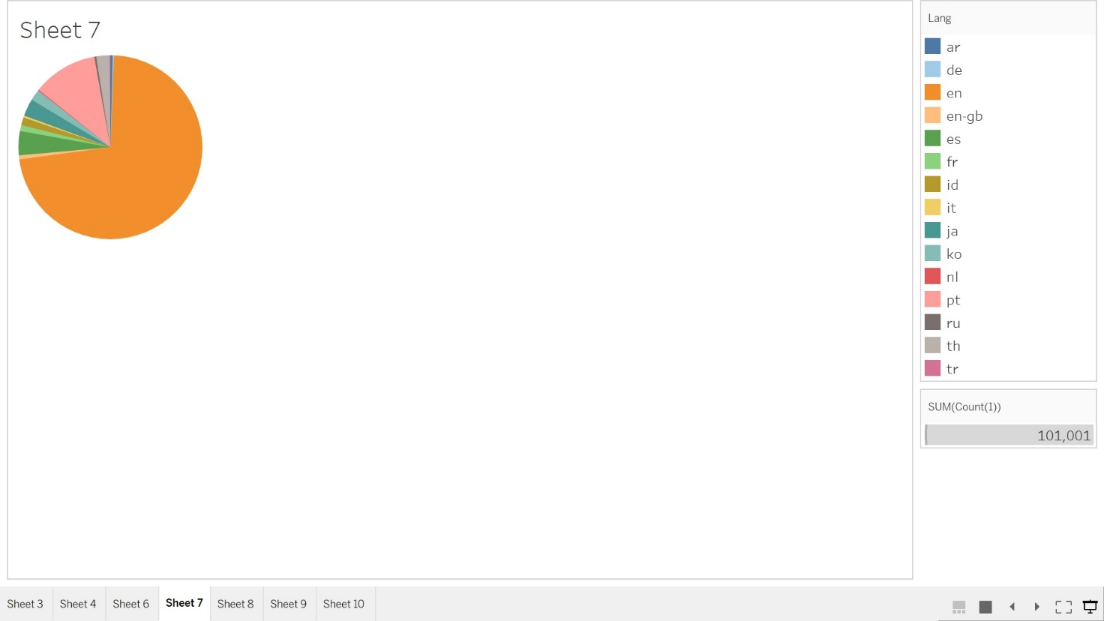
Output
Top 10 languages used in tweets

Slide 9
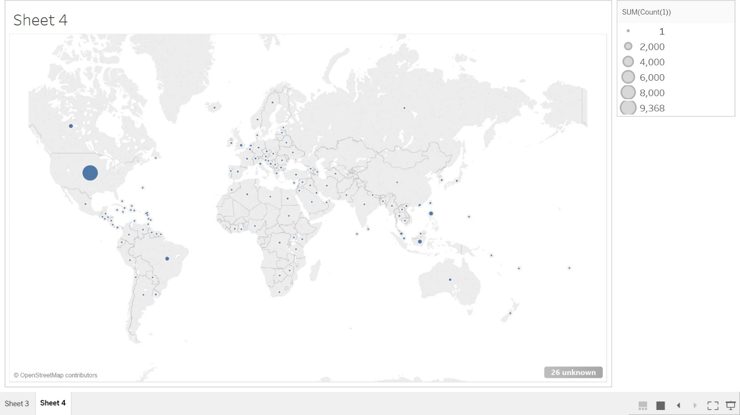
Output
Countries from which most tweets posted

Slide 10
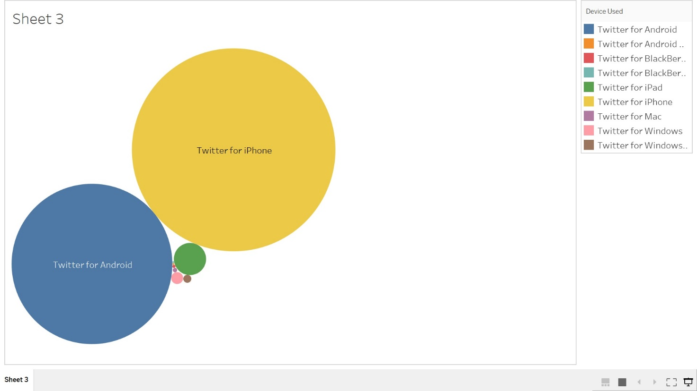
Output
Percentage of devices used for accessing Twitter

Slide 11

Output
Most repeated word in the Descriptions used in twitter

Slide 12
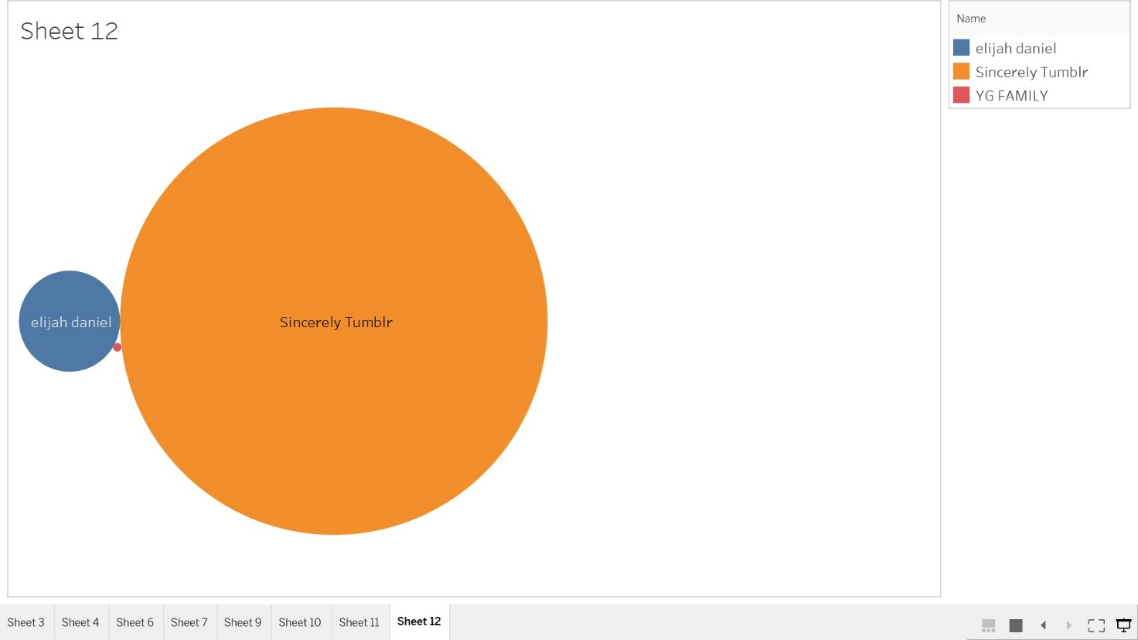
Output
Top 3 Users with highest number of followers count

Slide 13
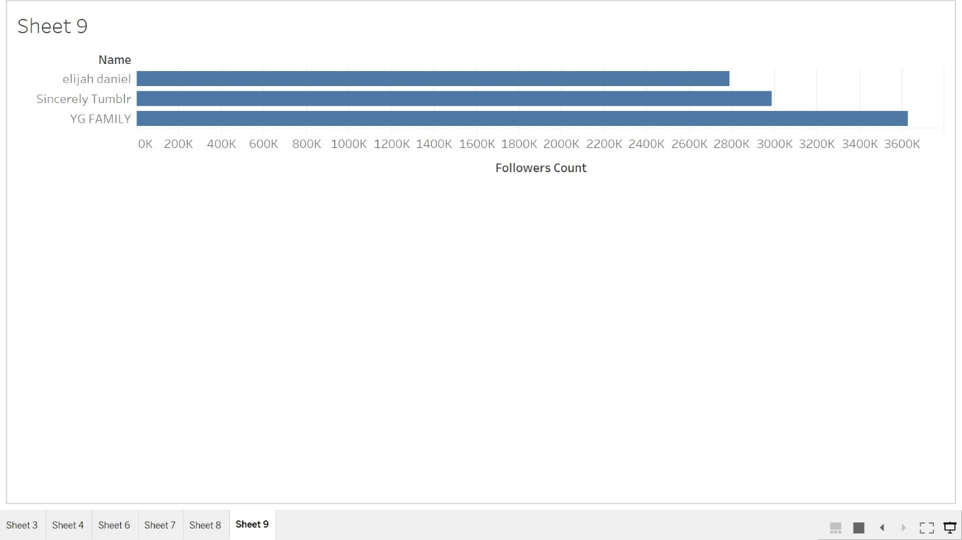
Output
Top 3 Users with highest number of followers

Slide 14
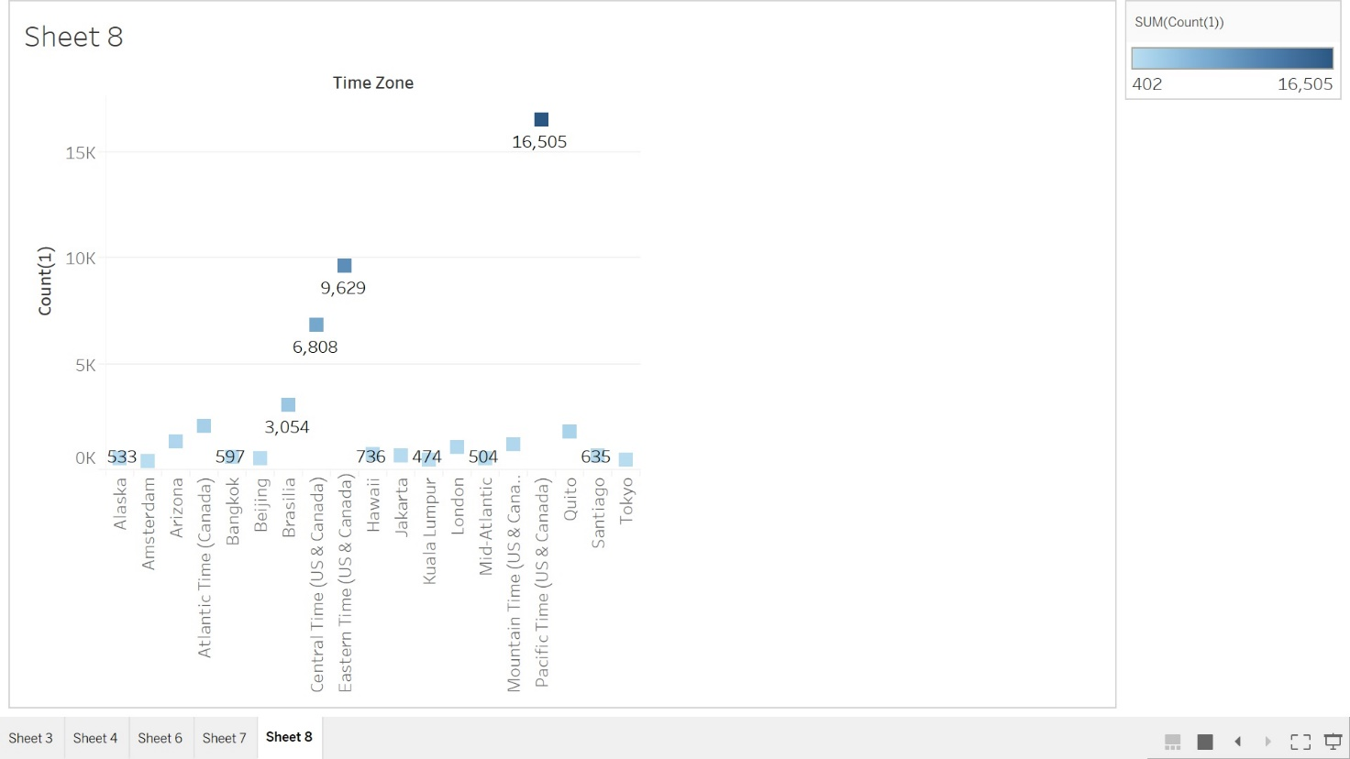
Output
Most Popular Time Zones

Slide 15
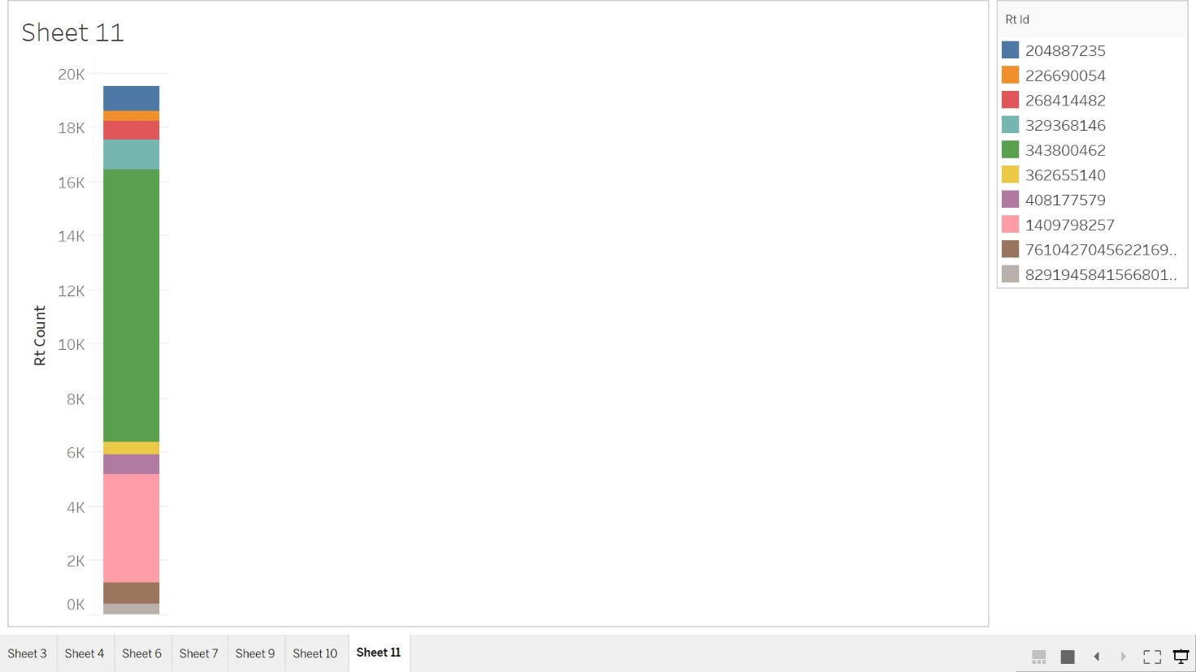
Output
User who has retweeted most of the time

Slide 16
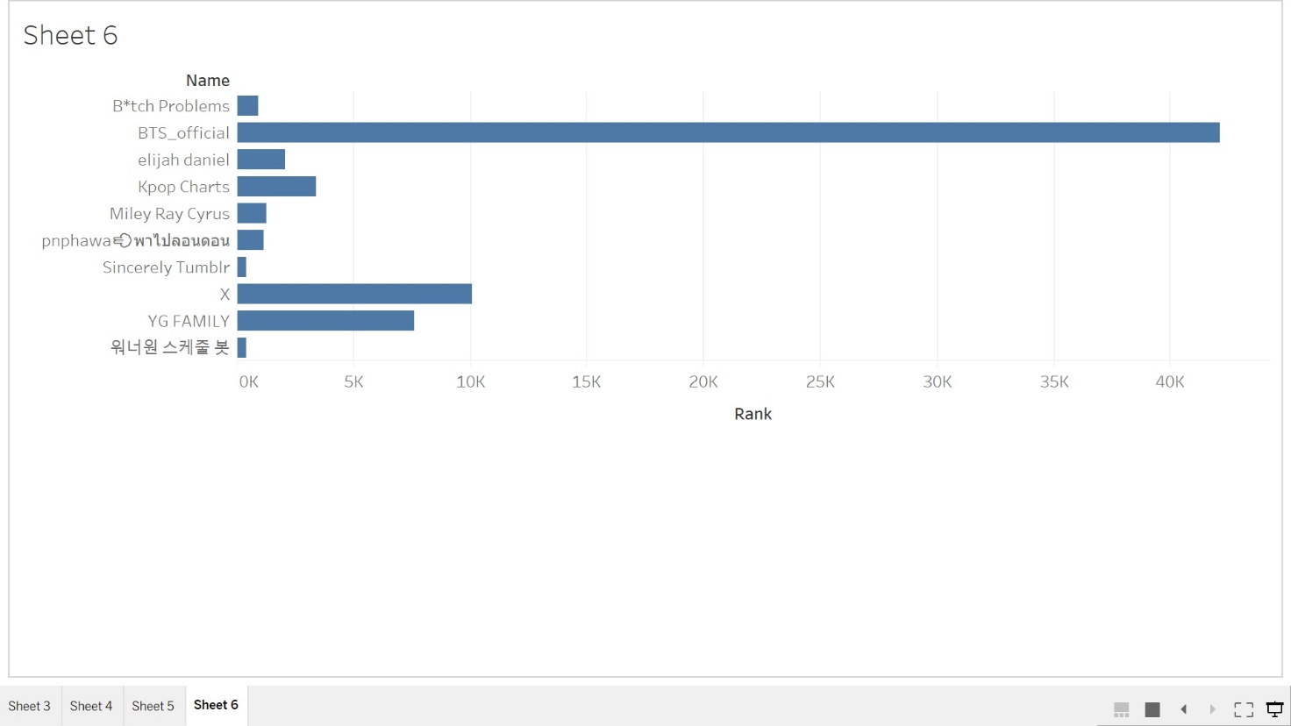
Output
Twitter user with highest rank number

Slide 17


